Slide 1
How to Write a Strategy
DD Kullman

Slide 2
Ad Strategy Defined
Advertising strategy is that portion of a brand’s marketing strategy which deals with advertising copy.
It’s a statement which identifies the basis upon which we expect consumers to purchase our product in preference to the competition.

Slide 3
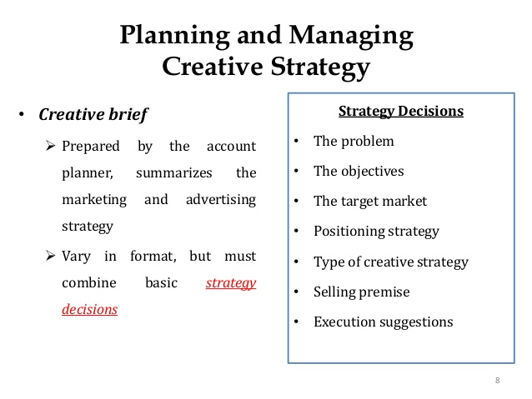
The Format
Simple
Used by clients and agencies such as P&G and Leo Burnett
Has three parts:
An objective statement
A support statement
A statement of tone or “brand character”

Slide 4
It Looks Like This…
Advertising will [CONVINCE/PERSUADE] [TARGET CUSTOMER] that [PRODUCT/BRAND] is/will/provides [STATEMENT OF BENEFIT/USP].
Support will be [SUPPORT/REASON WHY].
Tone will be [“SELLING ATTITUDE” ADJECTIVES].
Notes:
Text in parentheses is where students will fill in the information based on their chosen client.

Slide 5
An Objective Statement
The objective is stated within this first section of the strategy.
It identifies the brand’s target customer.
(Working women/fashion-conscious women, 18-35, etc.)
It states the objective, which is usually (but not always) communicating a meaningful benefit.
Product
Customer
Competition / Positioning
Notes:
ADVERTISING WILL CONVINCE AUTOMATIC DISHWASHER OWNERS…

Slide 6
Objective Statements
Advertising will convince automatic dishwasher owners that Cascade provides virtually spotless end results.”
Advertising will convince adults who eat cookies that Archway Oatmeal Cookies are uniquely delicious and nutritious.

Slide 7

A Support Statement
This indicates the support you will use to “prove” your benefit.
It may be a “reason why” for that benefit, or it may be something else.
Very often, you will be communicating some form of superiority, uniqueness or differentiation in a convincing way. And be meaningful in terms of purchase behavior.
Notes:
“VIRTUALLY SPOTLESS END RESULTS WILL BE ATTRIBUTED TO THE SHEETING ACTION PRODUCED BY THE CASCADE FORMULA”
SUPPORT: A statement of the basic benefit which the product promises consumers and which constitutes the principal basis for purchase of that brand. It’s the REASON you can provide the benefit mentioned in the objective statement.
It may be psychological—such as “confidence” or “satisfaction.”
It might be tangible—”feels soft” or “tastes terrific”
Your product might be…easier (convenience strategy), cheaper (economy strategy) or better quality for the price (value strategy)
ADVERTISING WILL CONVINCE AUTOMATIC DISHWASHER OWNERS THAT CASCADE PROVIDES VIRTUALLY SPOTLESS END RESULTS.

Slide 8
Support Statements
Support will be: Virtually spotless end results will be attributed to the sheeting action produced by the Cascade formula.
Support is that: Special K is low in calories and sugar, and high in protein.
Support will be: Archway Cookies are made with nutritious oatmeal and are naturally low in sodium and fat. They contain no Palm Oil. Archway has many unique varieties.
Notes:
Where to find support…product facts, product benefits, consumer needs, consumer benefits, competitive advantages, positioning opportunities, whatever it takes to solve the problem.

Slide 9
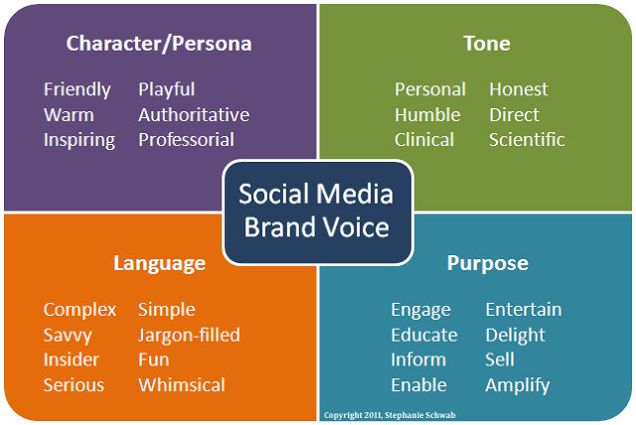
A Statement of Tone
This describes the desired “selling attitude” of the advertising.
Tone statements can provide additional insights into the target or as a description of the best advertising style for the product category. They are short-term and about the advertising.
Tone defines how you want to talk to your target audience.
Notes:
Today more companies are using brand character statements. These describe the enduring values of brands – values which are viewed as an important part of a brand’s equity in the marketplace.

Slide 10
Tone Statements
Tone will convey the spicy fun of Popeyes’ New Orleans heritage.
Tone will combine the importance of good nutrition with the fun of cookies.
Tone will reflect the fun of the pizza
eating experience.

Slide 11
Let’s practice!
Use the creative briefs provided and write a strategy for each.
Advertising will [CONVINCE] [TARGET CUSTOMER] that [PRODUCT/SERVICE]
is/will/provides [OBJECTIVE/BENEFIT]. Support will be [REASON WHY]. Tone will be [“SELLING ATTITUDE” ADJECTIVES].

